Slide 1
Name : Tahezeeb Jaweed Peerji
Project Title : Diabetes Risk Analysis
Domain : AI/ML
Week : 2
Pima Indians Diabetes Dataset
Pregnancies | Glucose | Blood Pressure | Skin Thickness | Insulin | BMI
Python • Pandas • Seaborn • Scikit-learn
Diabetes Risk Analysis • Project Presentation • 1

Slide 2
Project Overview
• Loads and inspects a diabetes dataset with 768 records and 9 columns.
• Checks missing values, duplicate rows, and medically implausible zero values.
• Cleans selected numeric features by replacing zero values with NaN and imputing the median.
• Explores the target variable and visualizes relationships among key features.
• Uses Python, Pandas, NumPy, Matplotlib, Seaborn, and Scikit-learn imports.
Records
Columns
768
9
No Diabetes
Diabetes
65.1%
34.9%
Diabetes Risk Analysis • Project Presentation • 2

Slide 3
Dataset & Variables
Pregnancies
Number of pregnancies
Glucose
Glucose level
Blood Pressure
Blood pressure
Skin Thickness
Skin thickness
Insulin
Insulin level
BMI
Body mass index
Diabetes Pedigree Function
Diabetes family-history score
Age
Age of patient
Outcome
0 = No Diabetes, 1 = Diabetes
Diabetes Risk Analysis • Project Presentation • 3

Slide 4
Data Quality & Cleaning
• Missing-value check: all 9 columns initially report 0 missing values.
• Duplicate check: 0 duplicate rows were found.
• The notebook identifies zero values in Glucose, BloodPressure, SkinThickness, Insulin and BMI as invalid for analysis.
• Those zeros are replaced with NaN, then filled using each column's median.
• After cleaning, the notebook reports 0 missing values.
zero_columns = [ "Glucose", "BloodPressure", "SkinThickness", "Insulin", "BMI"] df[zero_columns] = df[zero_columns].replace(0, np.nan) for column in zero_columns: df[column] = df[column].fillna(df[column].median())
Diabetes Risk Analysis • Project Presentation • 4

Slide 5
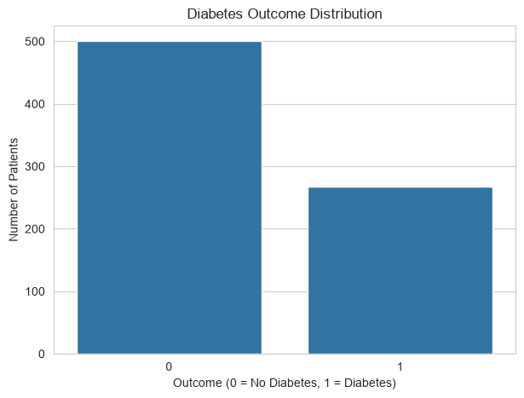
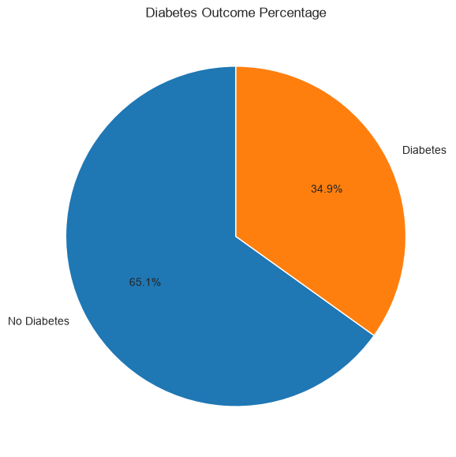
Target Variable Distribution
Outcome = 0
Outcome = 1
Class balance
500 patients
268 patients
65.1% / 34.9%
Diabetes Risk Analysis • Project Presentation • 5

Slide 6
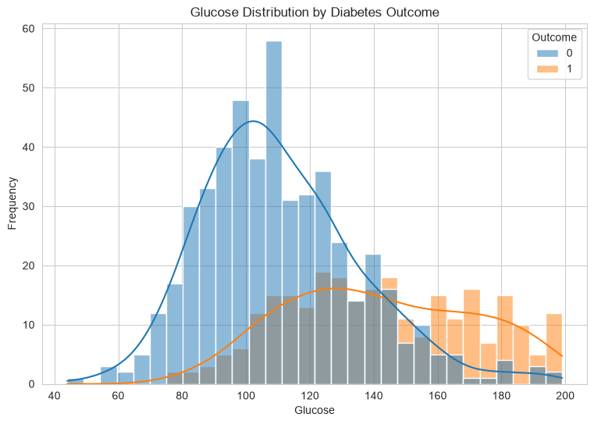
Correlation Analysis
sns.heatmap(df.corr(), annot=True, fmt=".2f", cmap="coolwarm")
Diabetes Risk Analysis • Project Presentation • 6

Slide 7
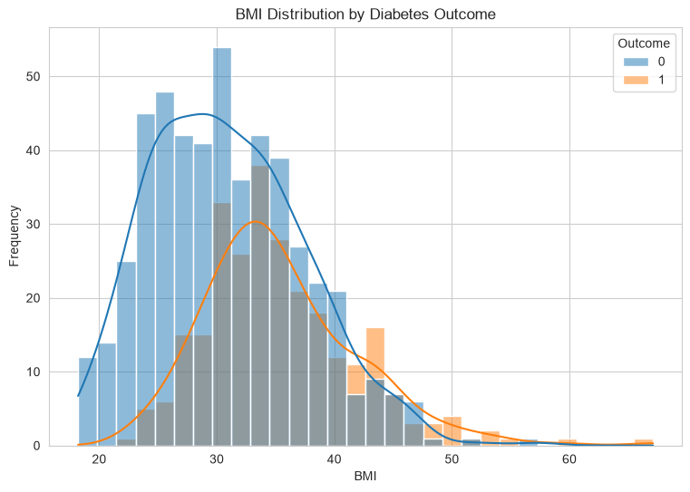
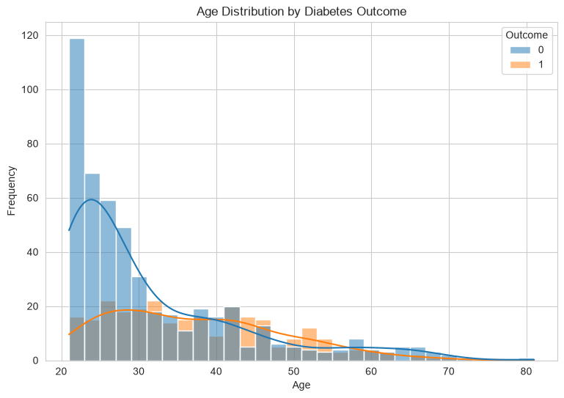
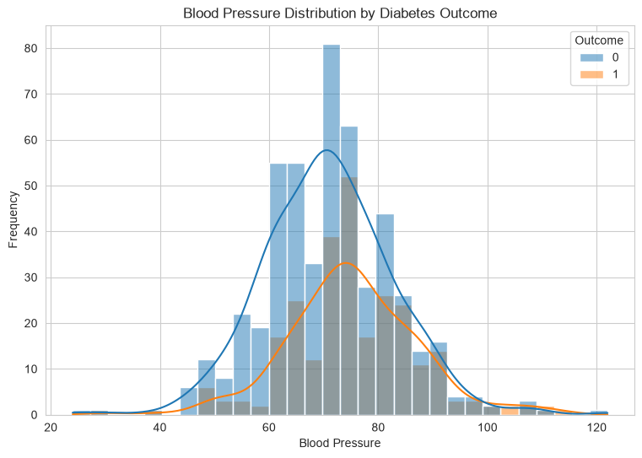
Feature Analysis
Glucose
BMI
Age
Blood Pressure
Diabetes Risk Analysis • Project Presentation • 7

Slide 8
Visualization Code
• Histograms compare distributions for Outcome 0 and Outcome 1.
• KDE curves provide a smoothed view of the distributions.
• The same approach is repeated for BMI, Age and BloodPressure.
# Glucose distribution by diabetes outcome plt.figure(figsize=(9, 6)) sns.histplot(data=df,x="Glucose",hue="Outcome",kde=True,
bins=30) plt.title("Glucose Distribution by Diabetes Outcome") plt.xlabel("Glucose") plt.ylabel("Frequency") plt.show() # Similar blocks are used for BMI, # Age and BloodPressure.
Diabetes Risk Analysis • Project Presentation • 8

Slide 9
Box-Plot Analysis
plt.figure(figsize=(8, 6)) sns.boxplot(data=df, x="Outcome", y="Glucose") plt.title("Glucose vs Diabetes Outcome") plt.show() plt.figure(figsize=(8, 6)) sns.boxplot(data=df, x="Outcome", y="BMI") plt.title("BMI vs Diabetes Outcome") plt.show() plt.figure(figsize=(8, 6)) sns.boxplot(data=df, x="Outcome", y="Age") plt.title("Age vs Diabetes Outcome") plt.show()
• Box plots make differences in central tendency and spread easier to compare.
• The supplied project examines Glucose, BMI and Age this way.
• These plots support exploratory analysis before any predictive modeling.
Diabetes Risk Analysis • Project Presentation • 9

Slide 10
Core Project Code
import numpy as np import pandas as pd import matplotlib.pyplot as plt import seaborn as sns import joblib from sklearn.model_selection import train_test_split from sklearn.preprocessing import StandardScaler from sklearn.linear_model import LogisticRegression from sklearn.tree import DecisionTreeClassifier from sklearn.ensemble import RandomForestClassifier from sklearn.neighbors import KNeighborsClassifier from sklearn.svm import SVC from sklearn.metrics import (accuracy_score, precision_score,recall_score, f1_score,confusion_matrix, classification_report, roc_curve, roc_auc_score) df = pd.read_csv("diabetes.csv")
Diabetes Risk Analysis • Project Presentation • 10

Slide 11
Project Workflow
1
2
3
4
5
6
Load Data
Inspect
Clean
Explore
Visualize
Interpret
• The notebook clearly implements data loading, quality checks, cleaning and exploratory visualization.
• It imports several machine-learning libraries, but the supplied code cell ends after exploratory plots.
• Therefore, this presentation does not claim model-training or accuracy results that are not present in the source notebook.
Diabetes Risk Analysis • Project Presentation • 11

Slide 12
Key Findings & Conclusion
• The dataset contains 768 patient records and 8 input features plus the Outcome target.
• The target contains 500 non-diabetic and 268 diabetic records.
• No missing values or duplicates were found initially.
• Zero values in selected physiological fields were treated as invalid and imputed with medians.
• The project provides a solid exploratory-data-analysis stage for a diabetes risk prediction pipeline.
• Next step, if required: train and evaluate the imported classification models using a train/test split and suitable metrics.
Diabetes Risk Analysis • Project Presentation • 12

Slide 13
Thank You
Diabetes Risk Analysis • Project Presentation • 13

